Slide 1

STATE OF THE WORKFORCE DASHBOARD AND TEXTUAL ANALYSIS OF EMPLOYEE REVIEWS
Week 2 : PROGRESS UPDATE

Slide 2
Updates
55% of data missing under the column – ‘ReviewText’
'Pros' and 'Cons' columns have only ~ 7% and 11% data missing, hence considering these two columns as well
TCS(~36K) has the highest number of reviews followed by Infosys(~22K), Wipro(~21K) and HCL(~18K)
Pre-processing of the textual data done

Slide 3
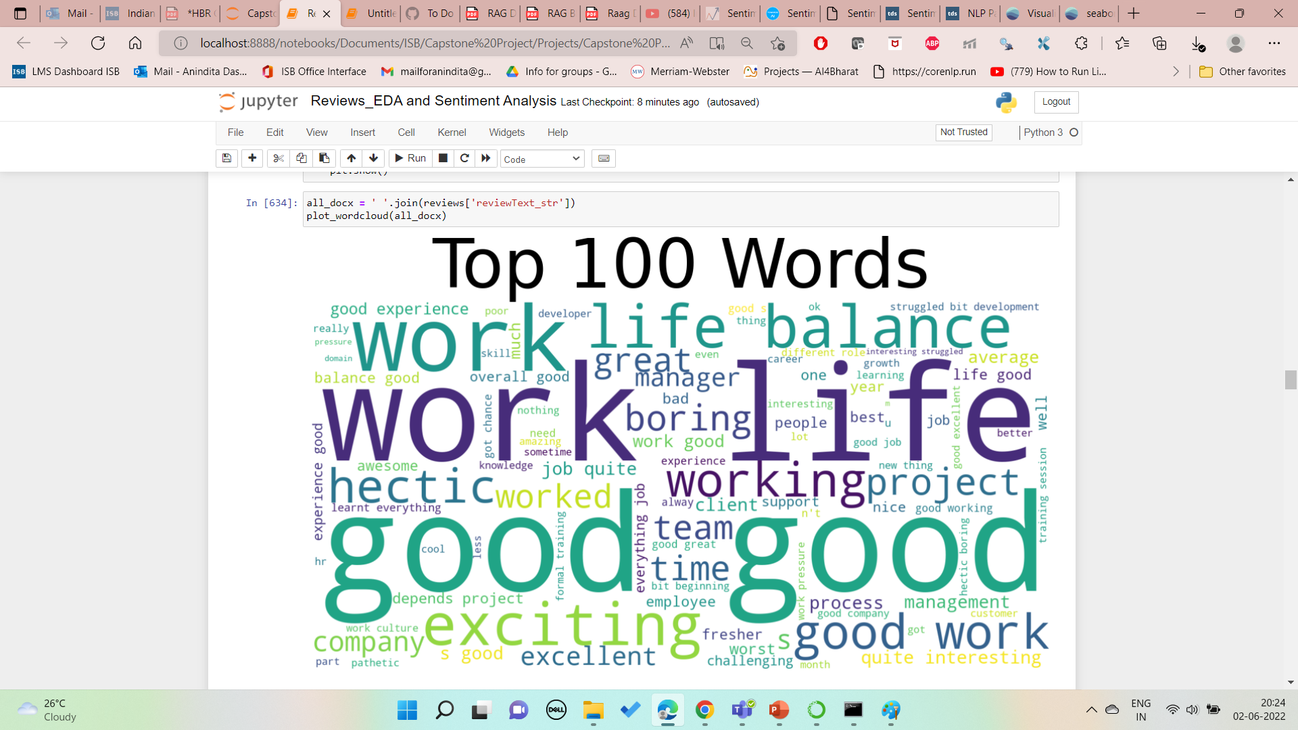
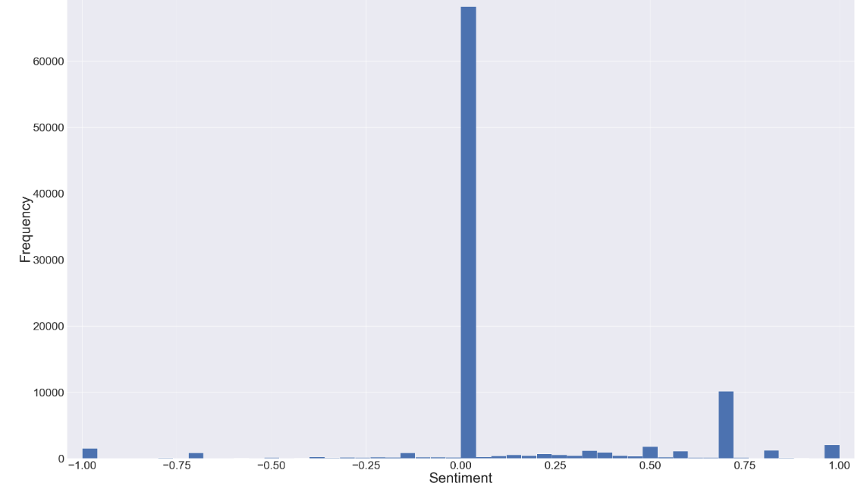
At an overall level
Distribution of the Polarity(Sentiment) Score
Negative
Sentiments
Positive Sentiments
Imbalanced Dataset
Overall sentiment is NEUTRAL

Slide 4
Pros and Cons by Company
Pros: Job Security, Work Culture
Cons: Compensation/Salary, Appraisal

Slide 5
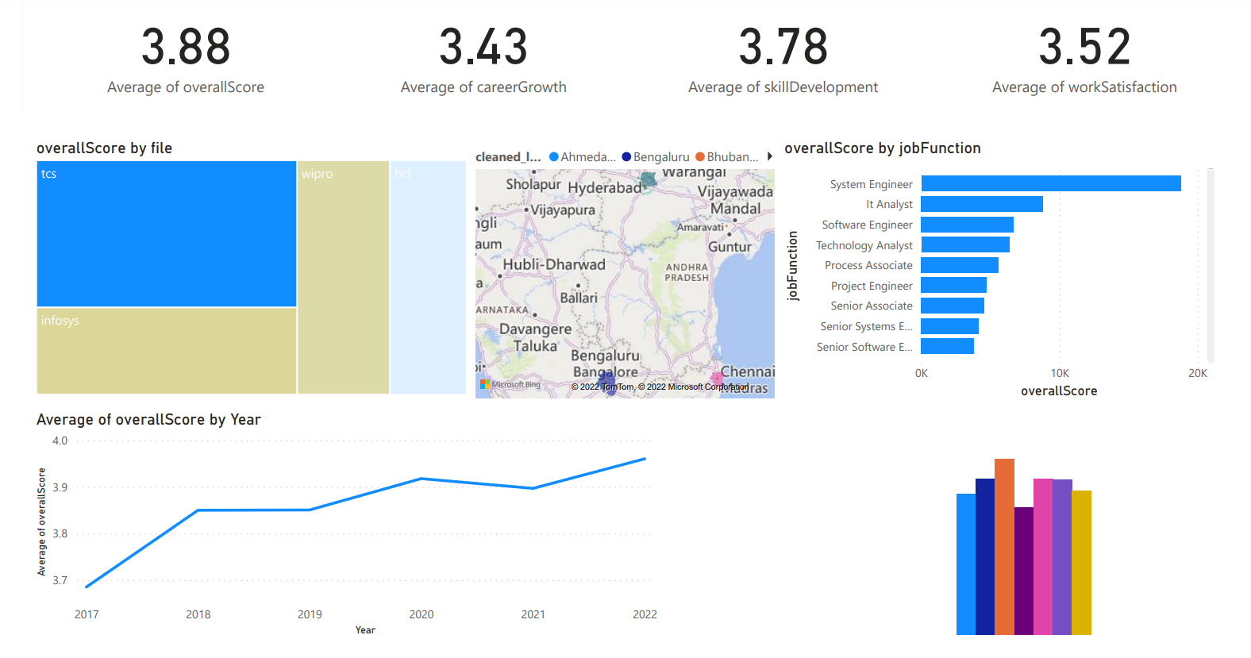
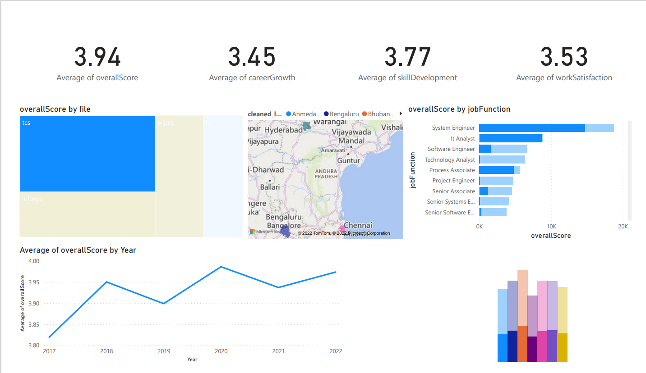
State of the Workforce – Mockup Dashboard
Drill-down view on TCS

Slide 6
Next steps (Week 3)
Add dynamic parameters, filters and other functionalities to the dashboard
Understand sentiment better: experimenting with different models, slicing and dicing the review data by job function, location etc., correlation of overall score with the sentiment
Topic Modelling: Sentiment by topic
Integrating the review data with the State of the Workforce dashboard
Text Summarization

